Slide 1

Time Contrasts and Conditional Sentences

Slide 2
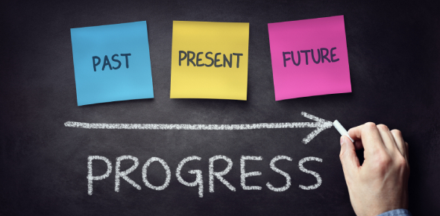
Time Contrasts: Past, Present and Future
Time contrasts are useful when discussing topics. They allow more complexity to express ideas and opinions. Certain time expressions are used with each tense.
For e.g.
Past: A few years ago, in the past, in the seventeenth century, in the 1950s
Present: These days, Today, Nowadays, This year
Future: Soon, in twenty years, in the future, in the next hundred days, in a year

Slide 3
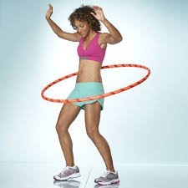
1950s-Hula Hoop
A hula hoop is a toy hoop that is twirled around the waist, limbs or neck. The modern hula hoop was invented in 1958 by Arthur K. Melin and Richard Knerr, but children and adults around the world have played with hoops, twirling, rolling and throwing them throughout history

Slide 4
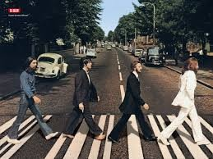
1960s-Beatlemania
The Beatles were an English rock band formed in Liverpool in 1960. Their best-known lineup, consisting of John Lennon, Paul McCartney, George Harrison, and Ringo Starr, became considered by many as the greatest and most influential act of the rock era

Slide 5

1970s-Disco
Disco is a genre of music that peaked in popularity in the late 1970s, though it has since enjoyed brief resurgences including the present day. The term is derived from discothèque (French for "library of phonograph records", but subsequently used as proper name for nightclubs in Paris). Its initial audiences were club-goers from the African American, gay, Latino, Italian American, and psychedelic communities in New York City and Philadelphia during the late 1960s and early 1970s.

Slide 6
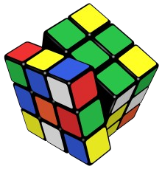
1980s-Rubik’s cube
Rubik's Cube is a 3-D combination puzzle invented in 1974 by Hungarian sculptor and professor of architecture Ernő Rubik.
January 2009, 350 million cubes had been sold worldwide making it the world's top- selling puzzle game. It is widely considered to be the world's best-selling toy.

Slide 7
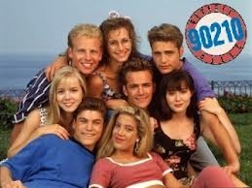
1990s-Beverley Hills
Beverley Hills 90210 is an American drama series that originally aired from October 4, 1990 to May 17, 2000 on Fox and was produced by Spelling Television in the United States, and subsequently on numerous networks around the world.

Slide 8
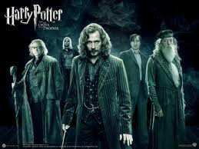
2000-Harry Potter
Harry Potter is a series of novels by J.K. Rowling. It is about a young boy named Harry Potter and his adventures as he attends Hogwarts School, learns how to perform magic and comes face to face with his arch enemy, Lord Voldemort.

Slide 9
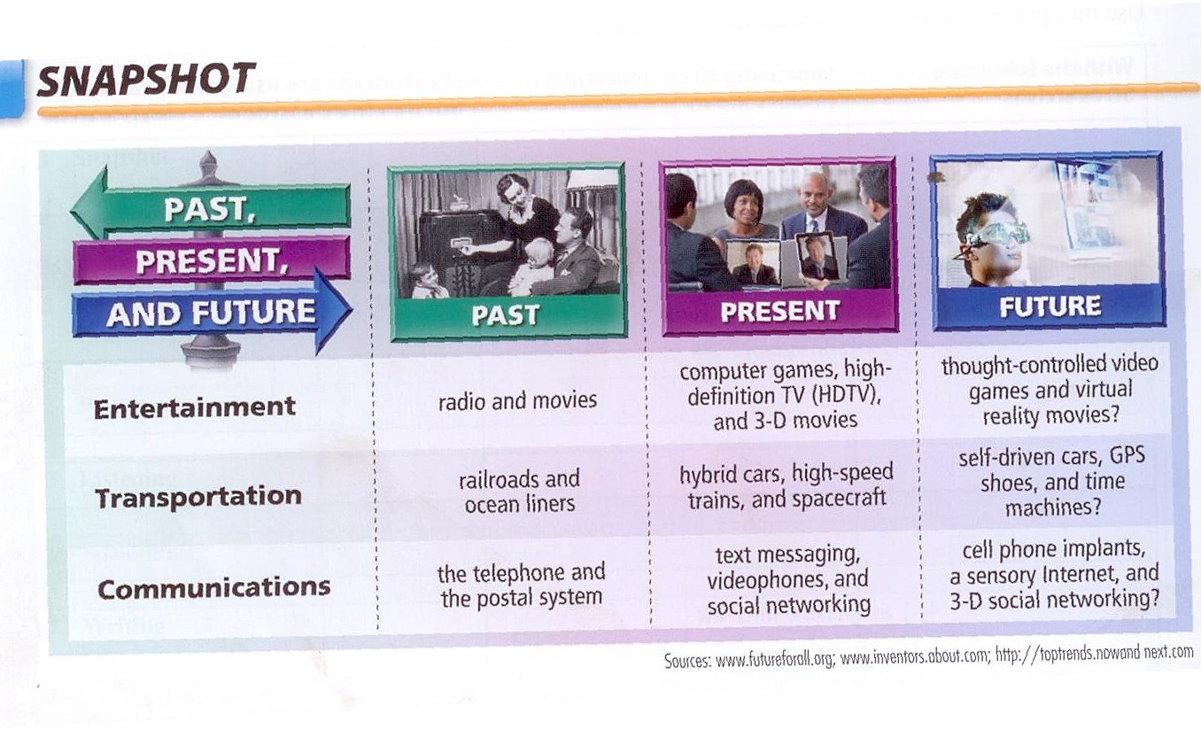

Slide 10
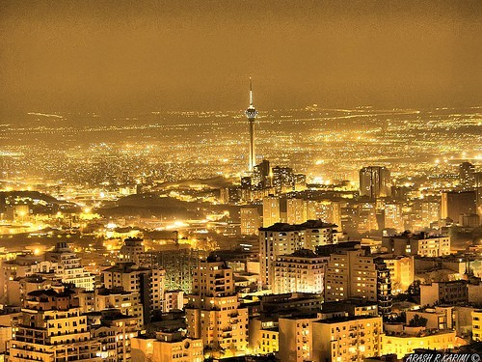

In the past people used to live in old houses. A few years ago, people in big cities used to sit in the evenings on the sidewalks
10 years ago, the students visited the library to search some information.




Slide 11

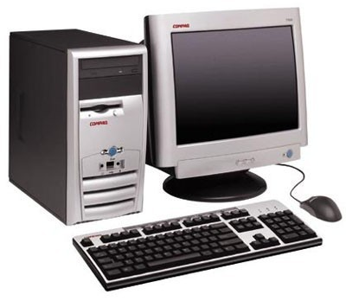
Nowadays, teenagers and adults play video games
Today, our town has a better public transportation
These days, computers have thinner screen
Nowadays, everyone has his/her own cellular.






Slide 12
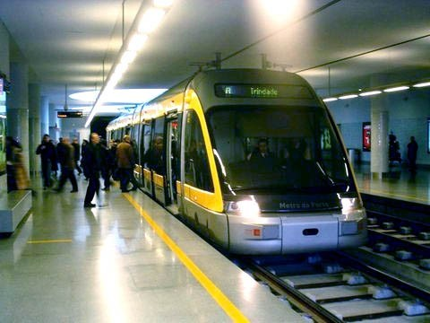

In twenty years, Caarapó might be a big city.


In the future, students are going to take classes at home.
Soon, there will be smart classroom in all the schools.


In the future, Douradosc will have subways and better service transportation.

In ten years, people might buy groceries at home.

Slide 13

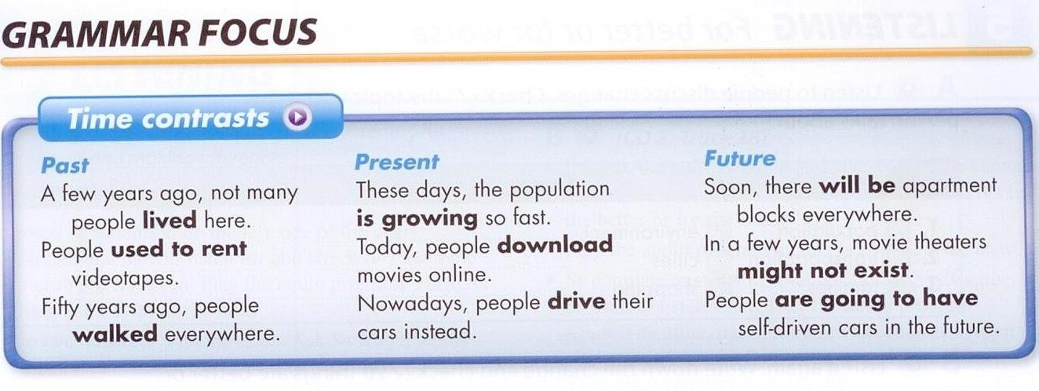

Slide 14

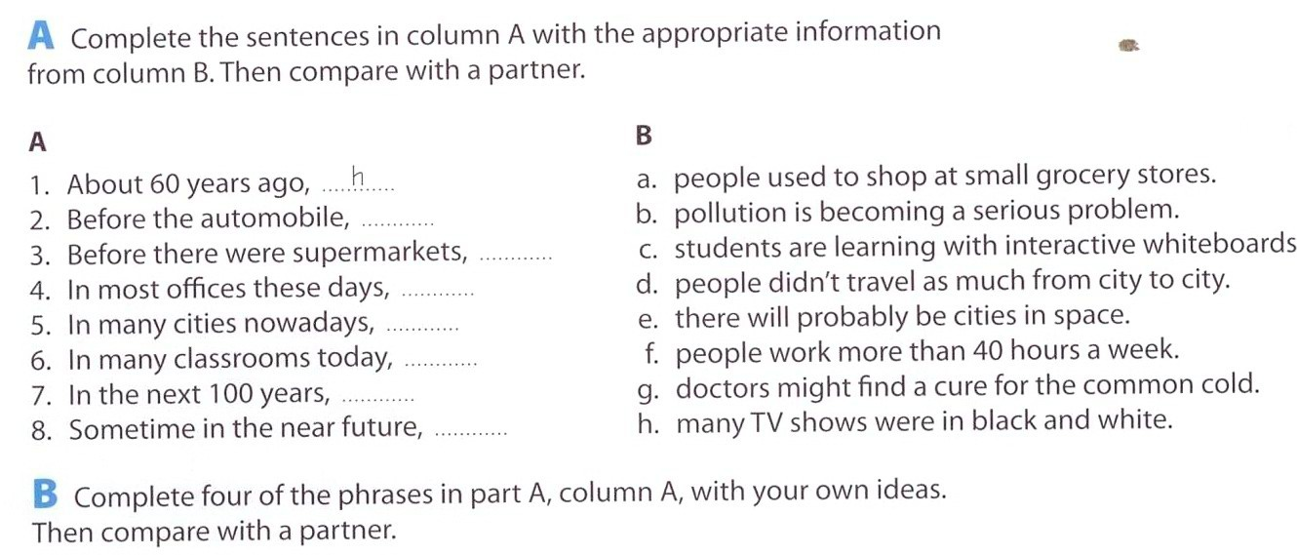

Slide 15

In the past, I
Nowadays , I wear casual clothes.
In the future, I
am going to wear formal clothes.
used to wear
tennis shoes and shorts.
A few years
In these days, I am living in
Brazil.
In ten more
years, I will be living in
Paraguai.
ago, I was
living in USA.

Slide 16
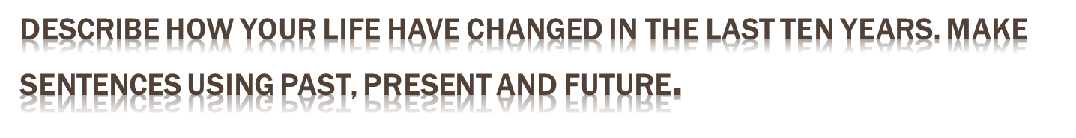
Ten years ago, I
was in elementary
Nowadays, I am
teaching and I love it.
In the futute, I am going to teach in the university.
school and hated
my teachers.

Slide 17
Conditional sentences with if clauses
Conditional sentences are also known as Conditional Clauses or If clauses. They are used to express that an action in the future will only happen is a certain condition is fulfilled by that time.

Slide 18
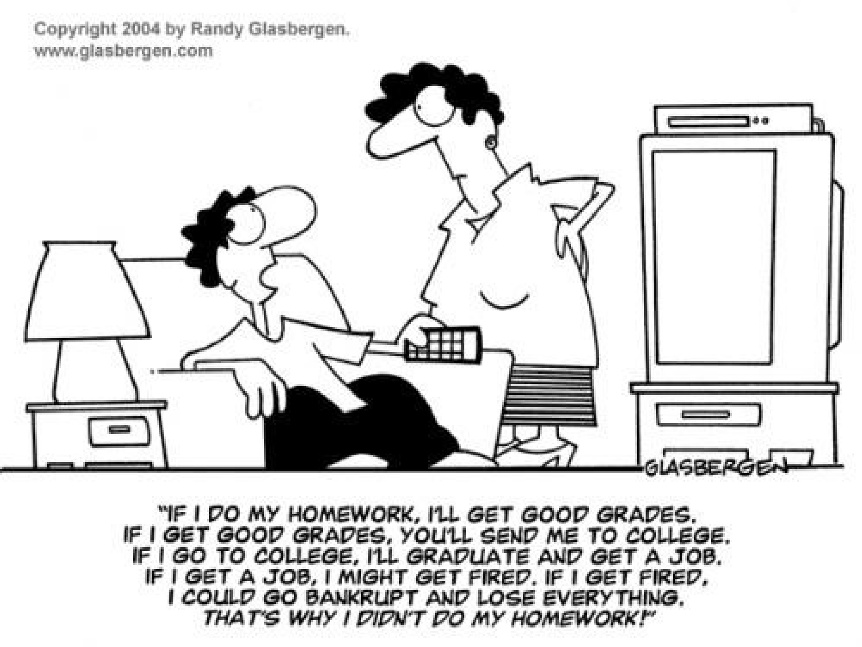

Slide 19

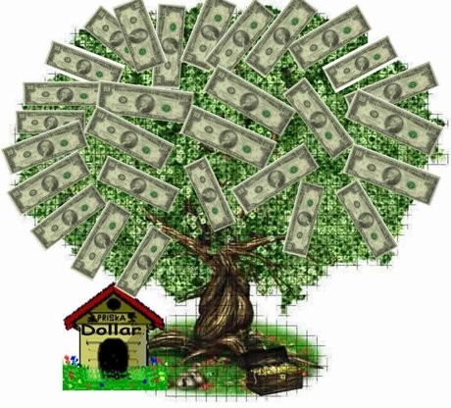

You will be able to make a tour to Europe
You will have to open a bank account
You might get a BMW
You will be able to
study abroad
You might get a bodyguard
You may have your own plane

Slide 20
If Clause-First conditional
Possible situation
If I fall in love
If I am happier
If I work better
If I get a raise
If I get married
If I have a lot of kids
If I have more expenses
If I don’t buy a car
Consequences
I will be happier.
I will work better.
I will be able to get a raise.
I may get married.
I will have a lot of kids.
I might have more expenses.
I won’t be able to buy a new car.
I will be so sad.
I will be happier

Slide 21


